Slide 1
General Assembly Meeting
9.15h – 11.00h
23 October
2018

Slide 2
Agenda
Welcome
President, Serge Devynck | president@natocharitybazaar.org
Webmaster, Lara Ronayne Casimiro | web@natocharitybazaar.org
Bazaar 2018, Berthold Malms | coordinator@natocharitybazaar.org
VIP-Morning-Coffee, Anja Malms I vice-president@natocharitybazaar.org
Guest Access, Anja Malms | guest-access@natocharitybazaar.org
Restaurant, Petra Kämmerer | restaurant@natocharitybazaar.org
Coffee Break
Tombola, Petra Havrankova | tombola@natocharitybazaar.org
Teen Helpers, Szabina Baros | secretary@natocharitybazaar.org
Treasurer, Sandra Santos | treasurer@natocharitybazaar.org
Any Other Business & Closing, Serge Devynck | president@natocharitybazaar.org

Slide 3
Welcome
Serge Devynck - President
Welcome
Voting for GAM minutes
(3rd October)

Slide 4
Farewell to Members
Serge Devynck - President
Anu Kalju (Estonia)
Ene Lehiste (Estonia)
Astrid Varenholz (Germany)
Eleni Zachariadi (Greece)
Aurelia Sikorska (Poland)

Slide 5
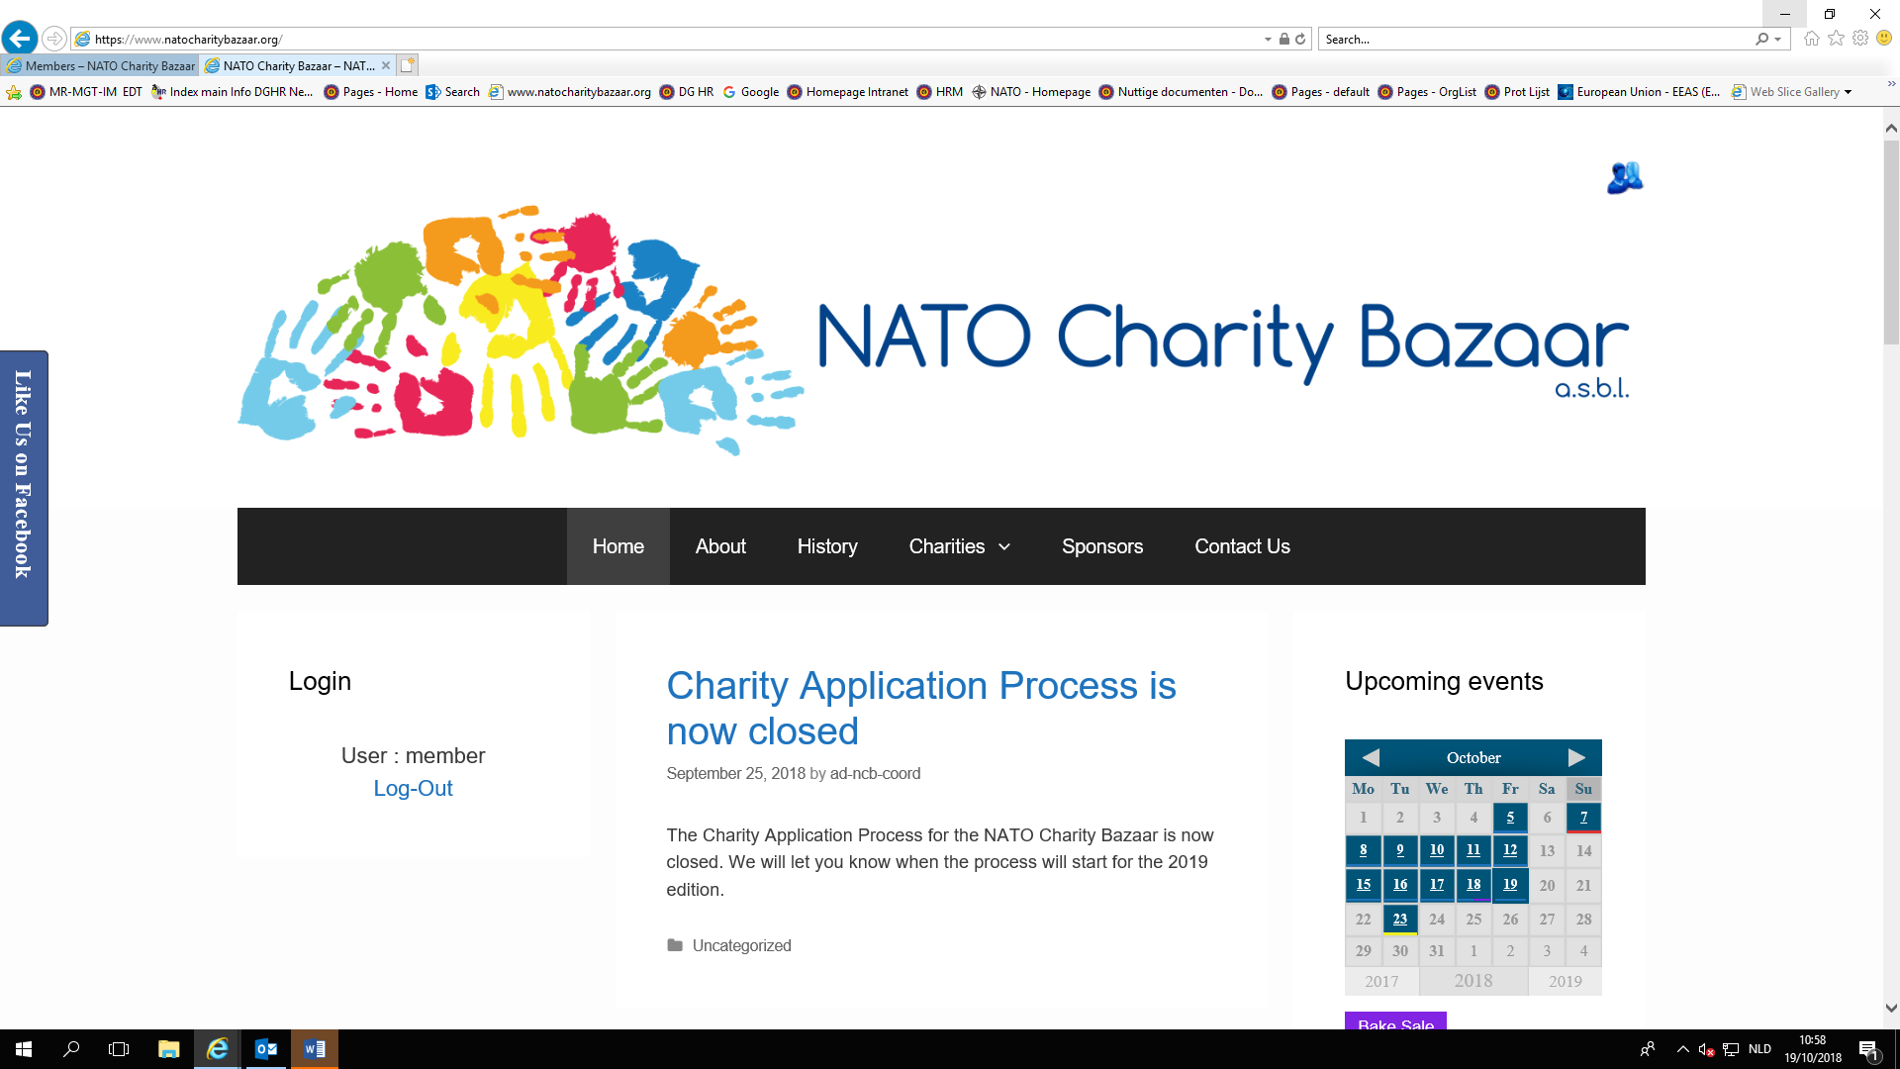

Slide 6
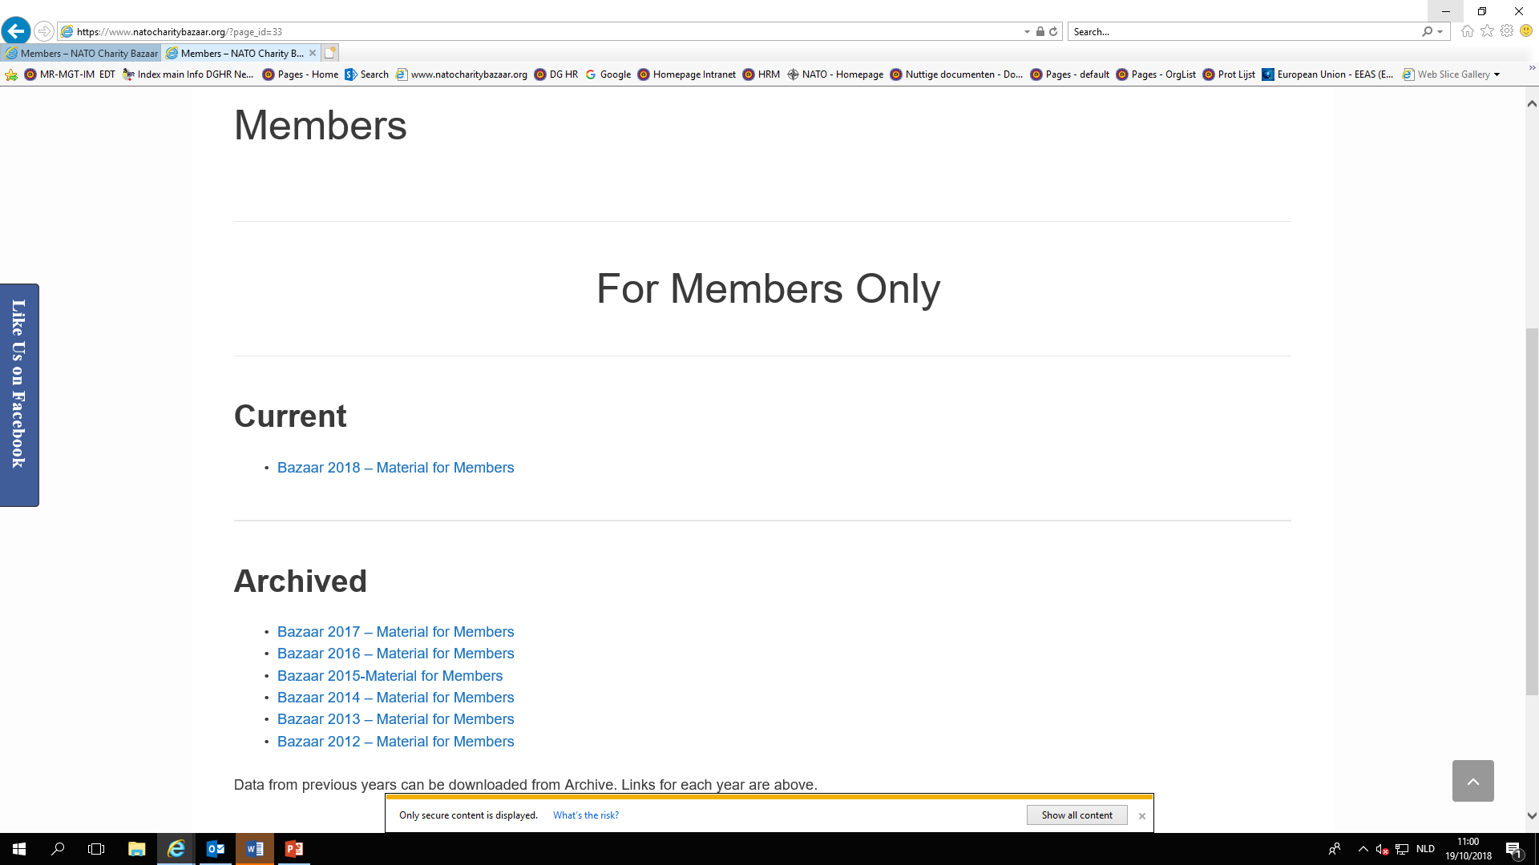

Slide 7
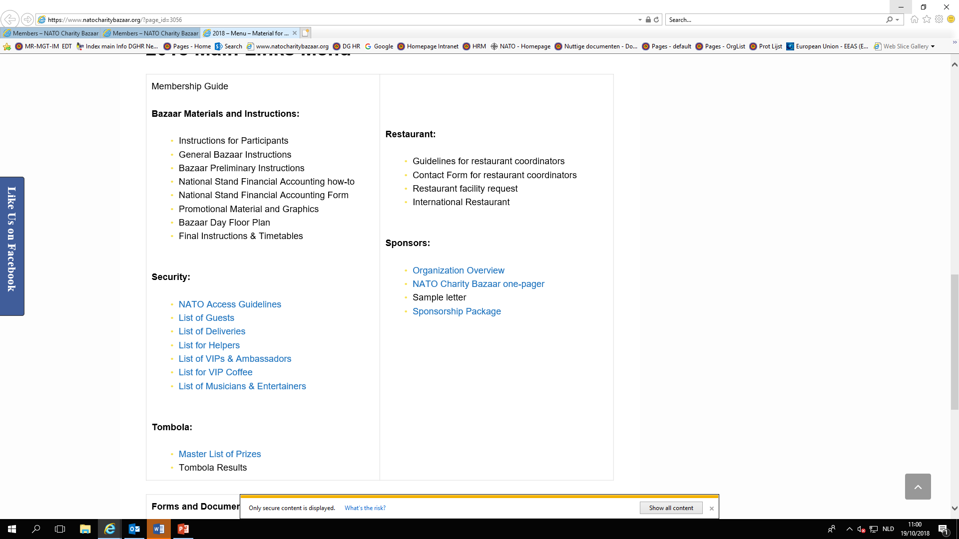

Slide 8
Bazaar Update
Berthold Malms - Bazaar Coordinator
NATO Charity Bazaar will take place Sunday, 18th November 2018
in the AGORA, Restaurant and Public Square Area of NATO HQ
meetings with IFM, Aramark ongoing
(President, Vice-President, Bazaar-Coordinator)
additional information (Floorplan, Instructions) will be send out
based on upcoming meetings
meetings with Group of Nations planned afterwards (if required)

Slide 9
Bazaar Update
Berthold Malms - Bazaar Coordinator
35 Nations signed up for National Stands
National Stand consist:
up to 10 tables in different shape (table size: 120x60)
no power supply
small storage behind each stand (no additional rooms)
boundaries / settings given by Floorplan
National Stands in alphabetical order (see Plan)
Nordic Stands combined (NOR/ISL/DEN/SWE/FIN)
Armenia
Austria
Belgium
Bosnia and Herzegowina (only restaurant)
Bulgaria
Canada
Croatia
Czech Republik
Denmark
Espana
Estonia
Finland
France
Georgia
Germany
Greece
Hungary
Iceland
Italy
Kazakhstan
Lithuania
Macedonia
Montenegro
Netherlands
Norway
Poland
Portugal
Romania
Serbia
Slovakia
Slovenia
Sweden
Switzerland
Turkey
United Kingdom
United States

Slide 10
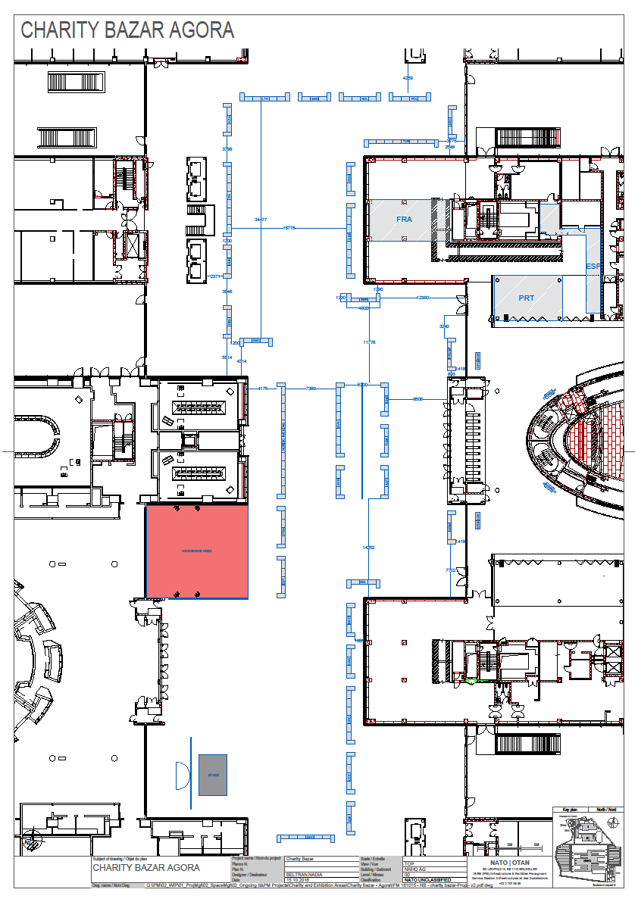

Slide 11
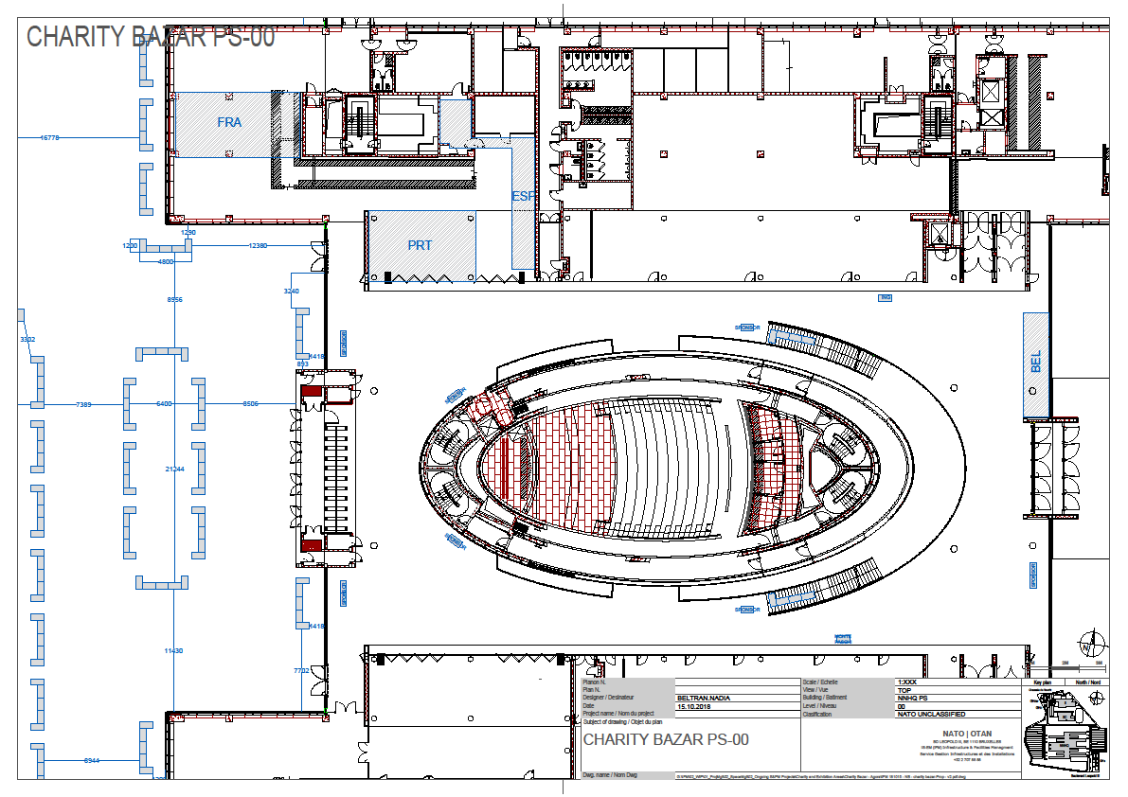

Slide 12
VIP-Morning-Coffee
Anja Malms – Vice-President
VIP Morning Coffee
18th November 2018
08:45 to 09:30
Hosted by
Azerbaijan

Slide 13
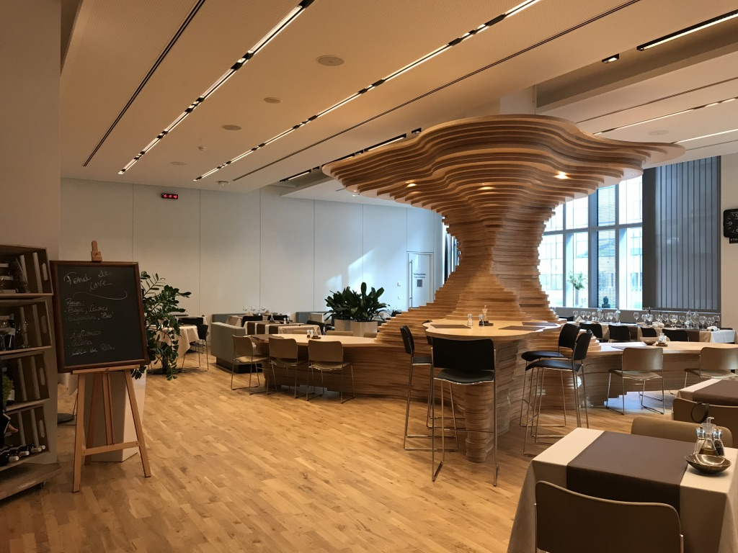
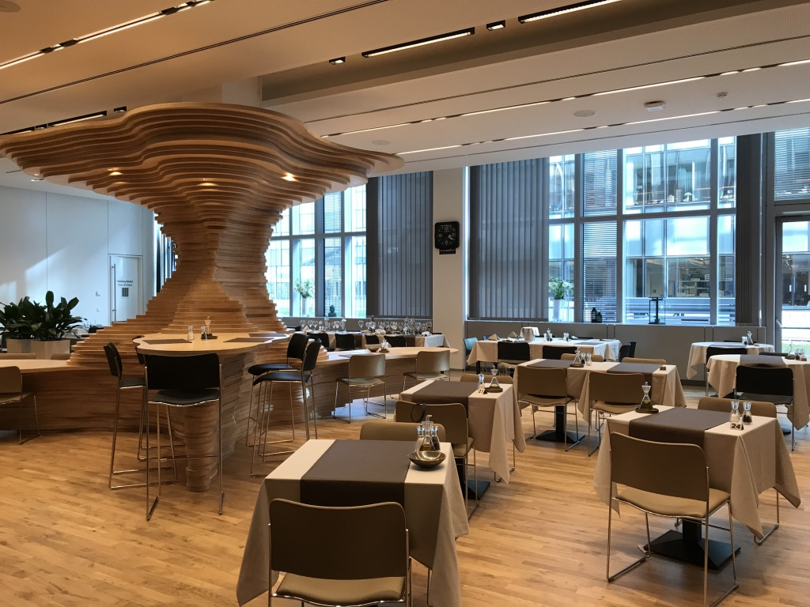
VIP-Morning-Coffee
Anja Malms – Vice-President
„DIPLOMAT“-Restaurant

Slide 14
VIP-Morning-Coffee
Anja Malms – Vice-President
max. 1-2 persons / Nation
the attending persons have to be added to the
VIP-Morning-Coffee list (already sent out & on the webpage)
Access: only through “Public Square” entrance
Access: only with “VIP-Morning-Coffee” invitation card
Take care, to check if an access pass to NATO HQ is needed too!

Slide 15
VIP-Morning-Coffee
Anja Malms – Vice-President
E-mail contact:
Vice-president@natocharitybazaar.org

Slide 16
Guest Access
Anja Malms – Guest Access Coordinator
Welcome to
Mr. Patrick Lambert
from
NATO Office of Security (NOS)

Slide 17
Guest Access
Anja Malms – Guest Access Coordinator
Who needs Guest Access passes?
everybody who has no valid NATO HQ PASS
or Family Badge
all SHAPE Members including their families,
with no valid access pass for the NATO HQ
(Shape members with no Amiscard)

Slide 18
Guest Access
Anja Malms – Guest Access Coordinator
For whom do the Nations need passes?
VIPs
Guests
Helpers
Commercial Deliveries
Musicians & Performers

Slide 19
Guest Access
Anja Malms – Guest Access Coordinator
VIPs
Ambassador or his Deputy or someone with similar status, his close family and the driver
max 5 persons in one car
only the Ambassador gets a VIP-pass
all in the car must be named in the VIP-list !
Sunday only
Access through South gate; parking available
Please write the correct title in the VIP-list !

Slide 20
Guest Access
Anja Malms – Guest Access Coordinator
GUESTS
max 5 guests / Nation
Access Sunday only
only on foot through South Gate
Use Visitor-parking in front of NNHQ at South Gate/ (limited space) or in front of the old NHQ

Slide 21
Guest Access
Anja Malms – Guest Access Coordinator
  Helpers (please use NATO personnel & family first)
12 without Restaurant Stand in total (SAT and SUN)
18 with Restaurant Stand in total (SAT and SUN)
Saturday and/or Sunday (one pass counts for one day)
Entrance through North Gate – Staffcenter

Slide 22
Guest Access
Anja Malms – Guest Access Coordinator
  Helpers
12 without restaurant stand in total (SAT and SUN)
18 with restaurant stand in total (SAT and SUN)
SATURDAY | SUNDAY | IN TOTAL
6 | 6 | 12
3 | 9 | 12
1 | 11 | 12
10 | 2 | 12
4 | 8 | 12

Slide 23
Guest Access
Anja Malms – Guest Access Coordinator
  Helpers
if one helper shall attend on both days, 2 passes are needed !
SA | SO | Surname | First name
X | X | Doe | Jane
X | X | Sample | John
X |  | Bloggs | Joe
 | X | Public | John Q.

Slide 24
Guest Access
Anja Malms – Guest Access Coordinator
Commercial Deliveries only!
(commercial truck/car as needed)
Saturday and/or Sunday
Entrance through North Gate – Staff Center
no parking – drop off and pick up only!

Slide 25
Guest Access
Anja Malms – Guest Access Coordinator
Musicians and Performers
limited to the number designated by the
“Entertainment Coordinator”
(please contact him/her: entertainment@natocharitybazaar.org)
Sunday only
Access through North Gate – Staff Center

Slide 26
Guest Access
Anja Malms – Guest Access Coordinator
Categorie | Day | Passes | Entrance | Parking
VIP | SUN | 1 per car | South Gate | available
Guests | SUN | 5 per nation | South Gate, by foot | Visitor Parking/ In front of NATO
Helpers | SAT and/or SUN | 12 (National Stand) 18 (National & Restaurant Stand) - IN TOTAL- | North Gate, by car or foot
Commercial Deliveries | SAT and /or SUN | - as needed - | North Gate | no parking, only drop off and pick up
Musicians and Performers | SUN | designated by Entertainment Coordinator | North Gate

Slide 27

Guest Access
Anja Malms – Guest Access Coordinator
Deadline
for any and all pass requests is
November 2, 2018 at 17:00
later requests will not be accepted!
NO EXCEPTIONS !

Slide 28
Guest Access
Anja Malms – Guest Access Coordinator
Email contact:
guest-coordinator@natocharitybazaar.org

Slide 29
“Thank you” -wine
Anja Malms – Vice President
“Thank You”-wine - for the NATO-Staff after the Bazaar:
Two bottles of wine as a donation from every participating nation
Latest until 13th of November at the last GAM before the Bazaar

Slide 30
Restaurant
Petra Kämmerer – Restaurant Coordinator
General Infos Kitchen Area:
Less space as in last years
2 convector ovens (to be used by 6 countries)
No freezer, only fridges
only one table in the preparing kitchen for all Nations
- so please prepare everything you can at home -

Slide 31
Restaurant
Petra Kämmerer – Restaurant Coordinator
General Infos from ARAMARK:
No use of the water dispensers allowed
Aramark cannot provide icecubes
Everyone who prepares or sells food or enter the kitchen area, has to wear hair-nets or caps
(hair-nets will be provided by Aramark)

Slide 32
Restaurant
Petra Kämmerer – Restaurant Coordinator
Waste:
No solution for the waste until now, so: - bring your own plastic bags or boxes
- take the waste with you at end of day

Slide 33
Restaurant
Petra Kämmerer – Restaurant Coordinator
EXIT
To kitchen
HUN
SVK
Turkey
France
DK
DK
DEU
DEU
EST
CAN
SLO
ITA
Cassa
PTG
Cassa
Cassa
ITA
GRC
CZE
DK
BiH
UK
Entrance

Slide 34
Restaurant Plan
Petra Kämmerer – Restaurant Coordinator
Kitchen area
EXIT
EXIT
EXIT
CRO
CRO
CRO
USA
USA
USA
BUL
BUL
BUL
LIT
LIT
LIT
Cassa
Cassa
Seating Area
Cassa
EXIT

Slide 35
Restaurant
Petra Kämmerer – Restaurant Coordinator
E-Mail contact:
restaurant@natocharitybazaar.org

Slide 36

Bake Sale
Petra Kämmerer – Event- Coordinator
2nd International Bake Sale
Thursday, 25 October, 2018
8.00h – 14.00h
in front of Starbucks Coffee

Slide 37

Coffee Break
15 min

Slide 38
Tombola Update
Petra Havrankova – Tombola Coordinator
Tombola Tickets Sale:
Look Book - Prizes – Box 73, works well
Distribution of tickets:
Need more tickets? Give me a call or send me an email
ACTION:
As soon as you know the prize to be donated, please fill in the form „Prize List 2018“ and send it to Petra at tombola@natocharitybazaar.org
Deadline: November 15
THANK YOU!
Other questions – please contact Petra via email or 0494 40 17 85

Slide 39
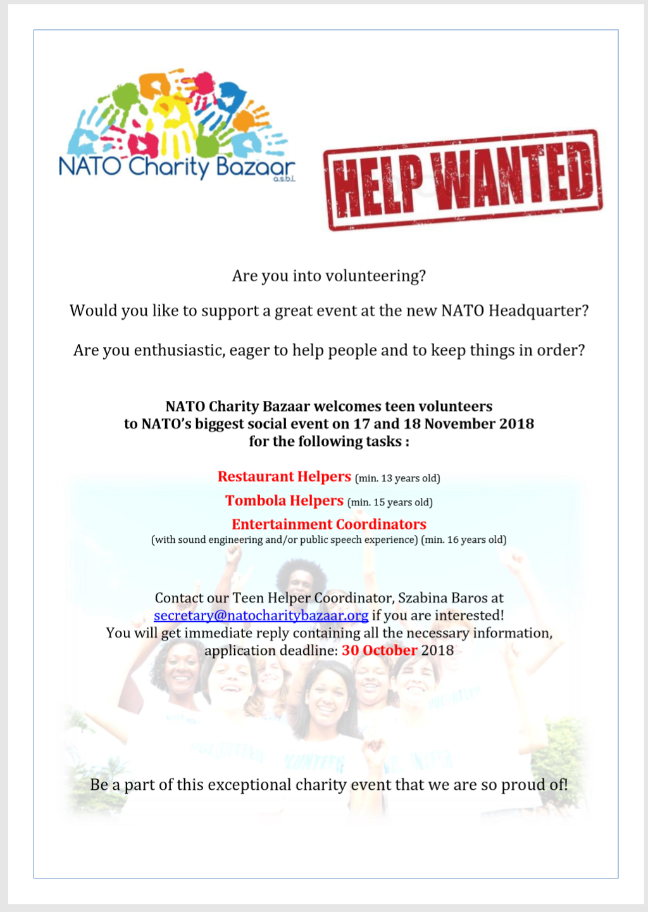
Teen Helpers
Szabina Baros – Secretary, Teen Helper Coordinator
We seek altogether
25 Teen Helpers
Areas:
Restaurant
Tombola

Slide 40

Teen Helpers
Szabina Baros – Secretary, Teen Helper Coordinator
They can choose to work on Saturday or Sunday
Shifts (3-4 h)
Min 13 years old
Wear a white T-shirt, we provide a name badge
Food vouchers
Certificate
If your kids are interested, please send an e-mail ASAP, but max 2 November
to secretary@natocharitybazaar.org → they will receive detailed info in reply

Slide 41

Teen Helpers
Szabina Baros – Secretary, Teen Helper Coordinator
We seek Entertainment Coordinators
Announcing performers, managing sound system
Older teenager or adult, spouse
Technical experience in use of microfon / sound engineering
Experienced or comfortable to speak on stage
Sunday only
Shifts
If interested, please send an e-mail ASAP, but max 2 November
to secretary@natocharitybazaar.org → they will receive detailed info in reply

Slide 42
Treasury Update
Sandra Santos – Treasurer
Treasurer update
How to transfer funds into the NCB account

Slide 43


Treasury Update
Sandra Santos – Treasurer
CONTRIBUTION 2018
Bake Sale €1.424
Others €32
1.456 EUROS
On 19 October

Slide 44

Transfer funds into the NCB account
Sandra Santos – Treasurer
Bazaar funds transfer instructions

Slide 45





Transfer funds into the NCB account
Sandra Santos – Treasurer
Bazaar funds transfer instructions

Slide 46
Transfer funds into the NCB account
Sandra Santos – Treasurer
Transfer funds by…
Online account transfer;
Bank transfer from your bank OR
Cash directly at the BMP Belgio at NATO HQ

Slide 47
Transfer funds into the NCB account
Sandra Santos – Treasurer
Transfer funds to
NATO Charity Bazaar ASBL Bank Account Details:
Banca Monte Paschi Belgio
- IBAN BE69 6434 0149 2878
- BIC BMPBBEBB

Slide 48

Transfer funds into the NCB account
Sandra Santos – Treasurer
Transfer funds
Include in the communication section of your transfer the message:
“Contribution to the NCB in 2018 by …
(specify your Nation’s Name)”

Slide 49

Transfer funds into the NCB account
Sandra Santos – Treasurer
Transfer funds
All transfers must be completed by:
Monday, 3 December 2018

Slide 50
Transfer funds into the NCB account
Sandra Santos – Treasurer
Accounting Form
Nation’s Name:
Person making the Bank Transfer:
Phone: |  |  | E-Mail:
NATIONAL CONTRIBUTION
Tombola Ticket Sales :
International Restaurant :
National Stand :
Total Bank Transfer Amount:

Slide 51

Transfer funds into the NCB account
Sandra Santos – Treasurer
Email
As soon as possible send via email to the NCB Treasurer
(treasurer@natocharitybazaar.org) a scanned copy of :
  - the completed “2018 Financial Accounting Form”;
  - your bank transfer transaction receipt.

Slide 52
Transfer funds into the NCB account
Sandra Santos – Treasurer
If you have any questions regarding this
“Bazaar funds transfer”, please don’t
hesitate to contact the
treasurer, Sandra, via email at
treasurer@natocharitybazaar.org

Slide 53
Any Other Business
Serge Devynck – President

Slide 54
2018 Dates
Serge Devynck – President
General Assembly Meetings:
  13th November
Please return
Voting Cards and Folders
Thank you for your participation

